Slide 1

NSG Pilkington – University of Liverpool Machine Learning Project: 12/05/2021
Dr. Peter Green
Diego Echeverria
Sarini Jayasinghe
Risk Institute,
School of Engineering

Slide 2
Today
Affect of signal processing on model performance
Regenerator Base and Regenerator Crown temperatures
Reversals
Combustion air flow
Mixture of Experts approach (if there’s time)

Slide 3
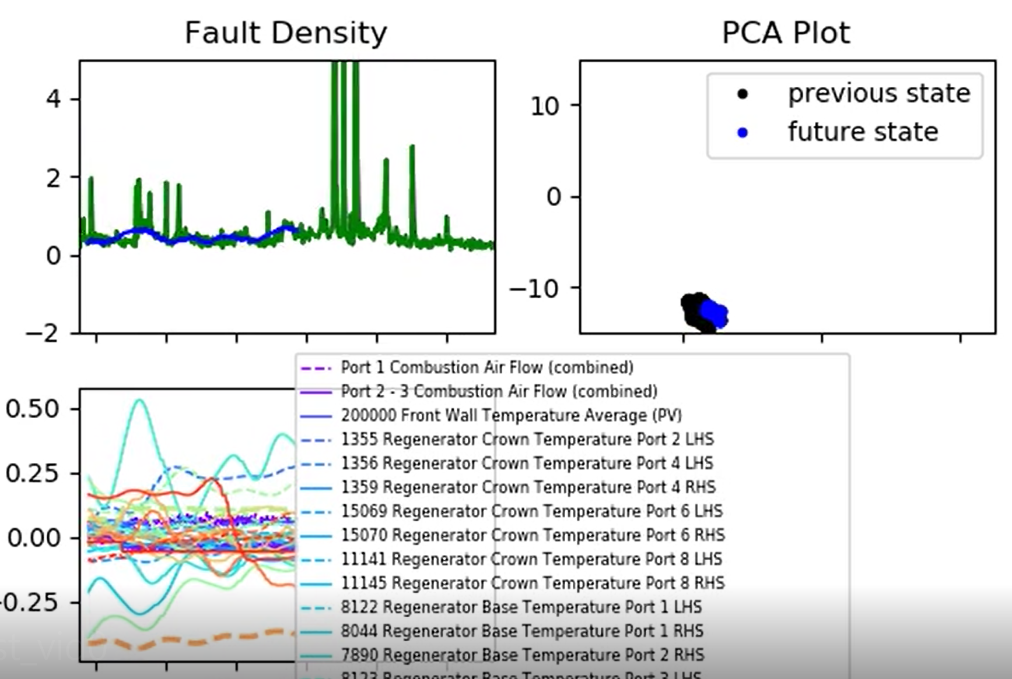
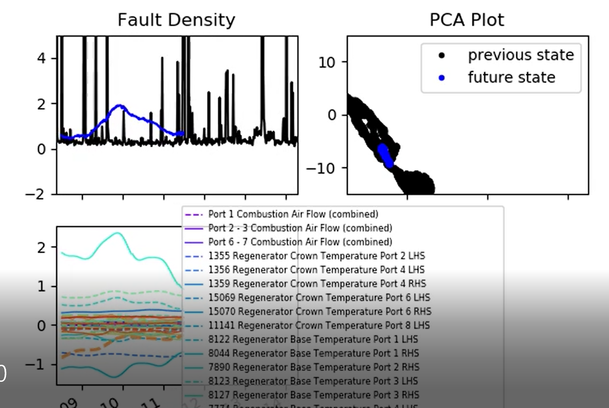
Affect of Signal Processing on Model Performance
Unfortunately we’re seeing overfitting (very good fit to the training data but predictions on new data deteriorate).
Here is an example where the importance of one of the Regenerator Crown / Base temperature is ‘over emphasised’. The same happens regardless whether or not we include LHS / RHS differences.

Slide 4
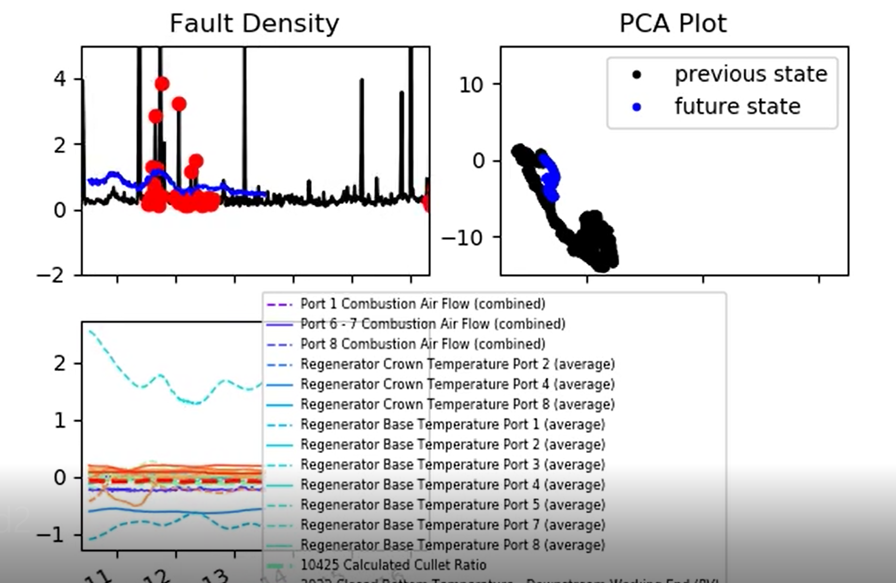
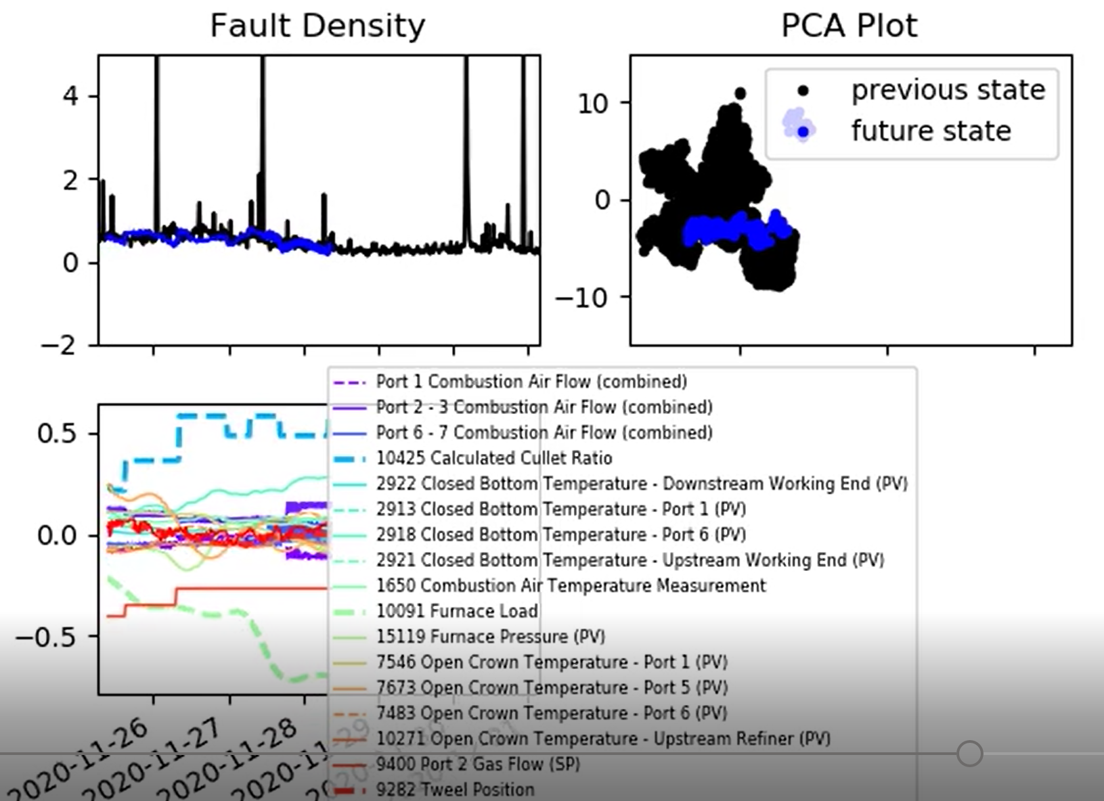
Affect of Signal Processing on Model Performance
We still get similar performance even just using the average of the Regenerator Crown and Regenerator Base temperatures (averaged across each port).
Perhaps because they are often correlated?
In fact, we can get better results by ignoring the Regenerator Crown and Regenerator Base temperatures completely (!)

Slide 5
Data Processing Pipeline (Standard)
1
0
Read raw data and time lag
Extract values & time stamps
Isolate over time period
Inside Eng min-max?
True
Enable?
Combination?
0
1
False
Process data outside limits
Data not found
Remove spikes?
0
0
0
Reversals?
Filtering?
Interpolate
1
1
1
Reversal processing
Low pass filter
Identify outliers (high pass filter)
Remove outliers

Slide 6
Data Processing Pipeline (Regenerator Base and Regenerator Crown Temperatures)
Identify pair of tags to be combined
Read raw data and time lag
Extract values & time stamps
Isolate over time period
Reversal processing
Remove spikes
Data not found
Interpolate
Signal 1
Low pass filter
Signal 2
Difference between 2 signals

Slide 7
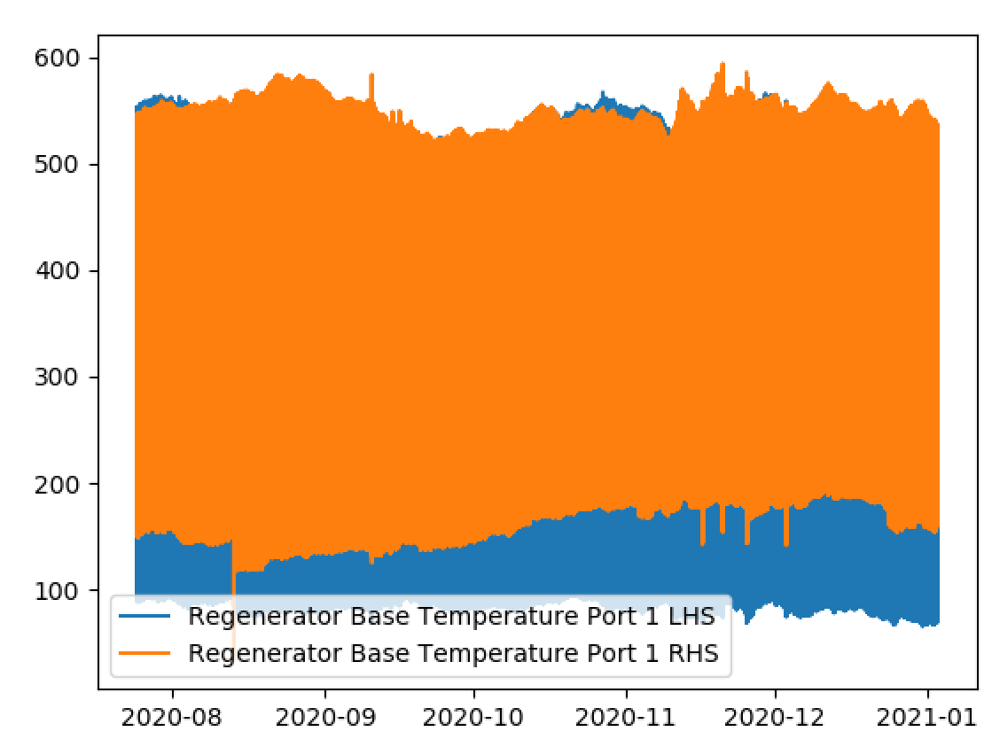
Data Processing Pipeline (Regenerator Base and Regenerator Crown Temperatures)
Identify pair of tags to be combined
Read raw data and time lag
Extract values & time stamps
Isolate over time period
Reversal processing
Remove spikes
Data not found
Interpolate
Signal 1
Low pass filter
Signal 2
Difference between 2 signals

Slide 8
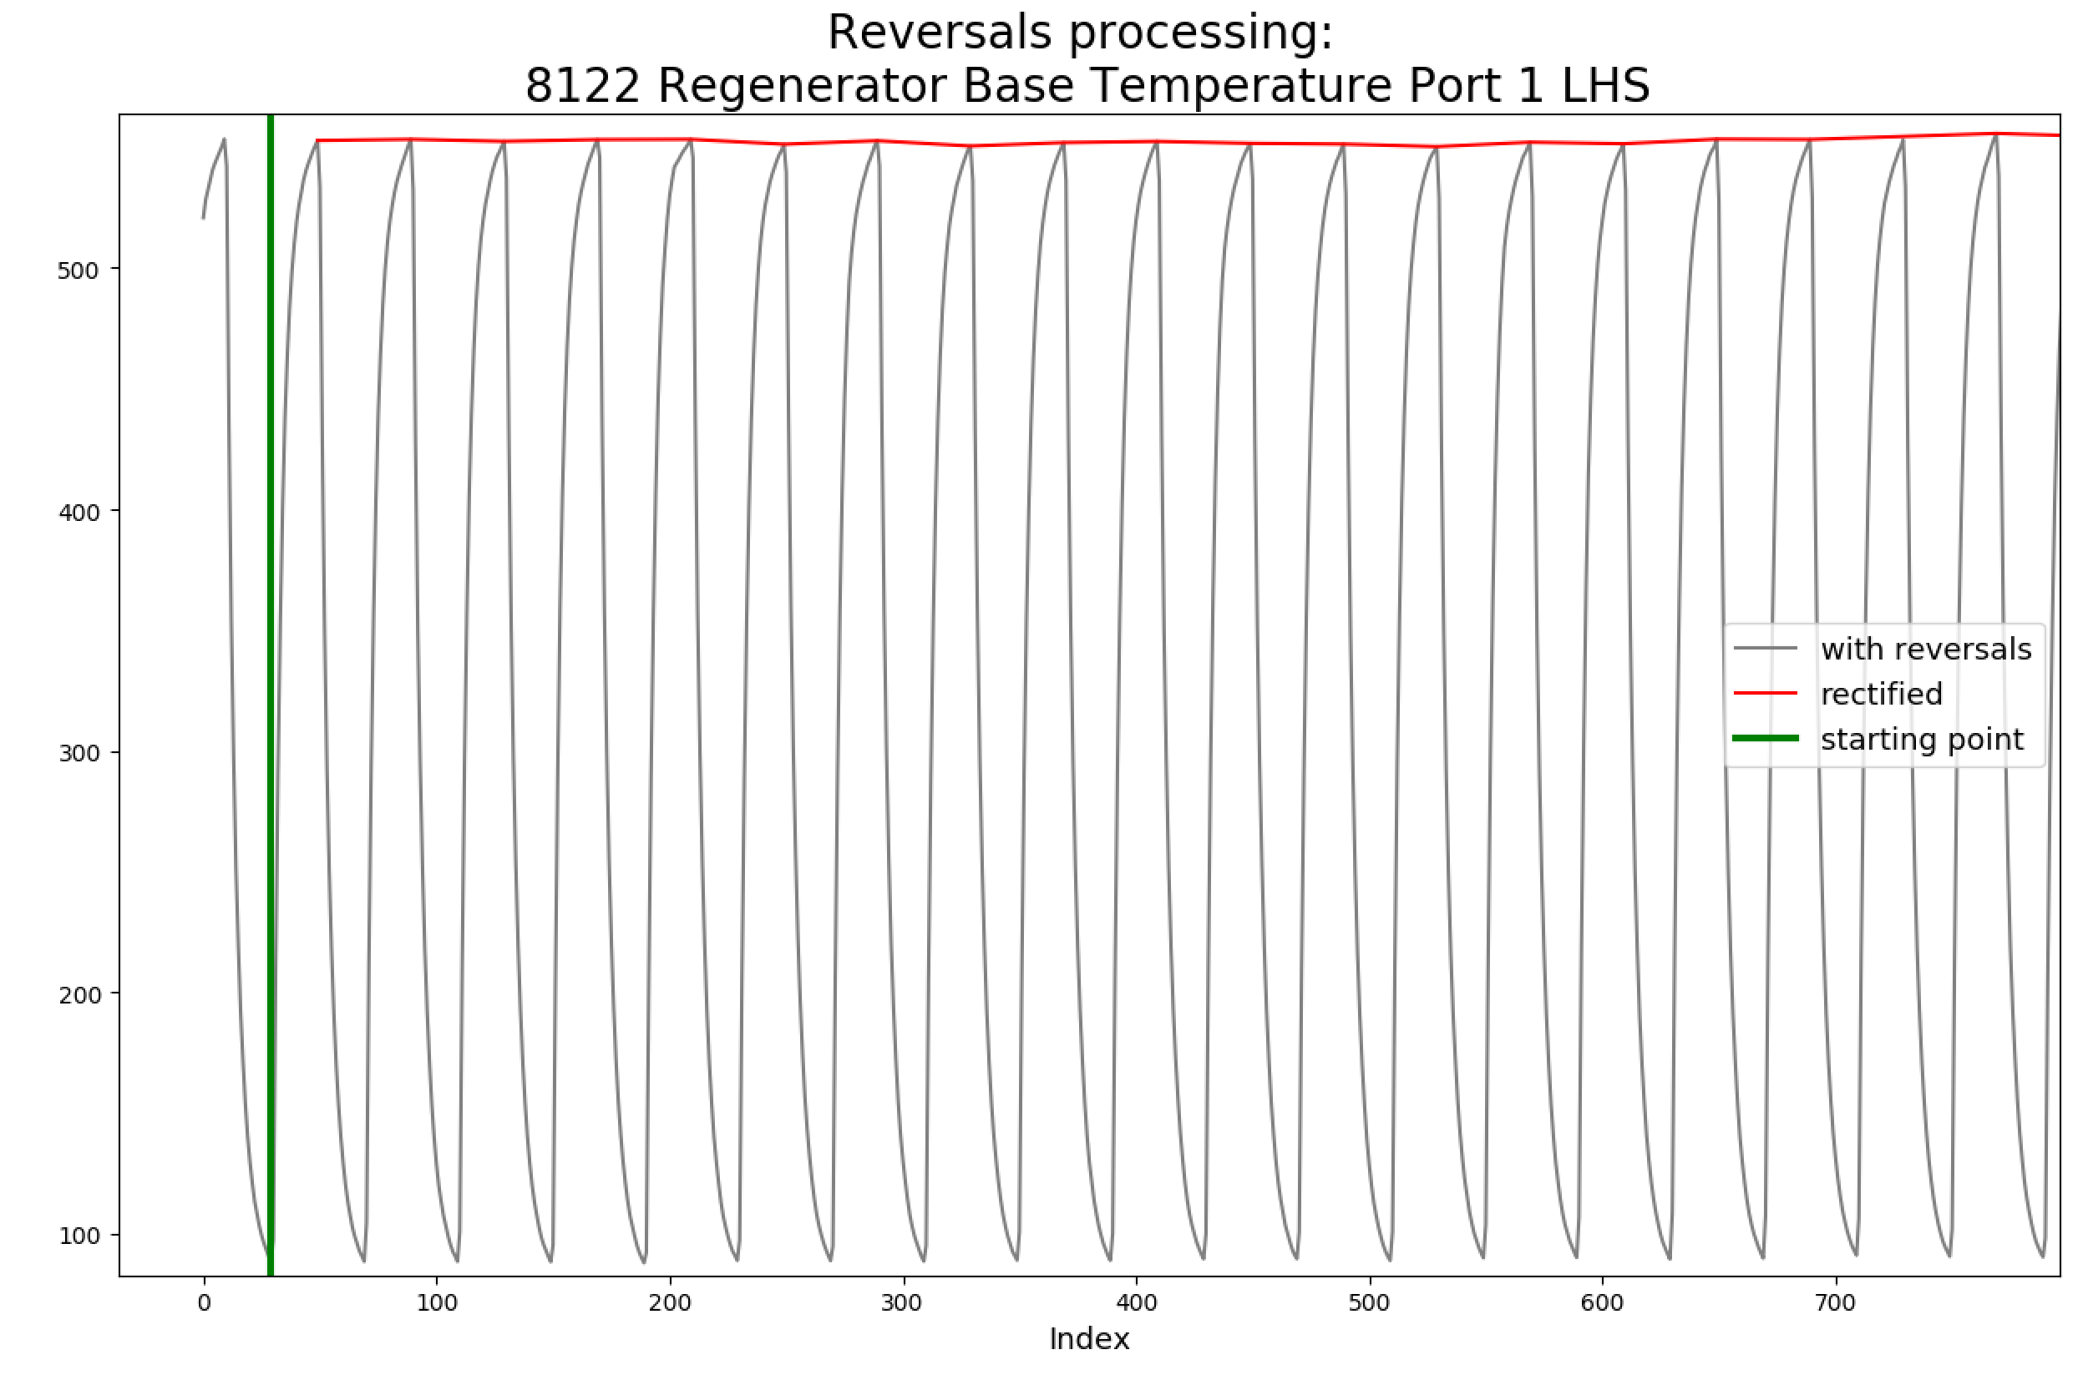
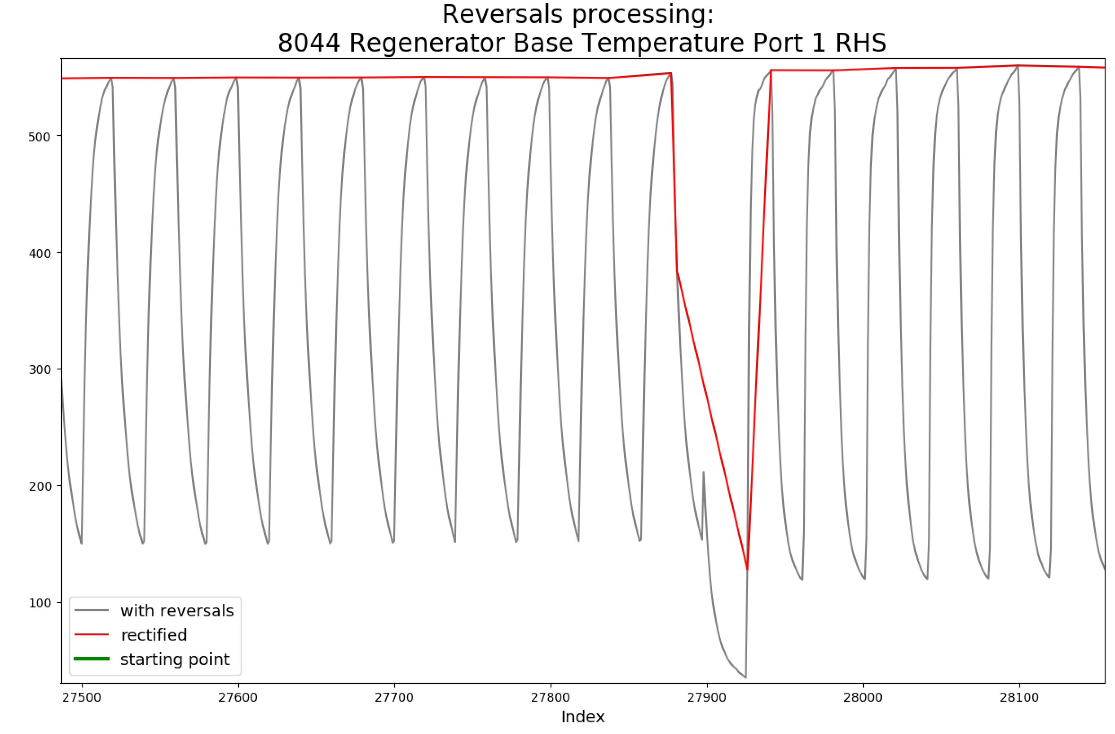
Data Processing Pipeline (Regenerator Base and Regenerator Crown Temperatures)
Identify pair of tags to be combined
Read raw data and time lag
Extract values & time stamps
Isolate over time period
Reversal processing
Remove spikes
Data not found
Interpolate
Signal 1
Interpolate
Low pass filter
Signal 2
Difference between 2 signals

Slide 9
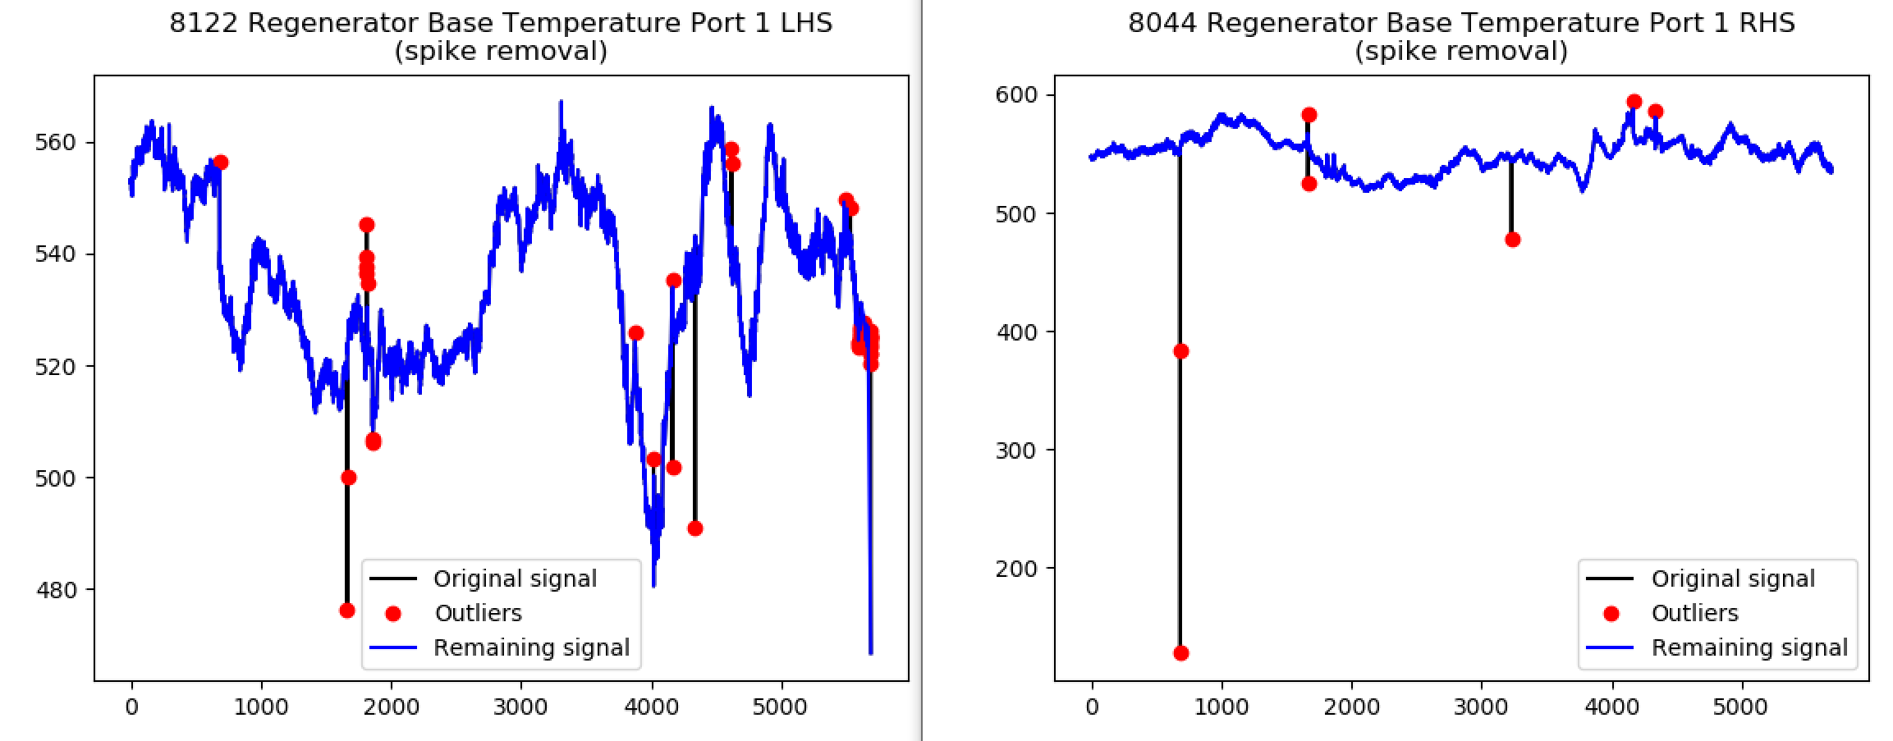
Data Processing Pipeline (Regenerator Base and Regenerator Crown Temperatures)
Identify pair of tags to be combined
Read raw data and time lag
Extract values & time stamps
Isolate over time period
Reversal processing
Remove spikes
Data not found
Interpolate
Signal 1
Low pass filter
Signal 2
Difference between 2 signals

Slide 10
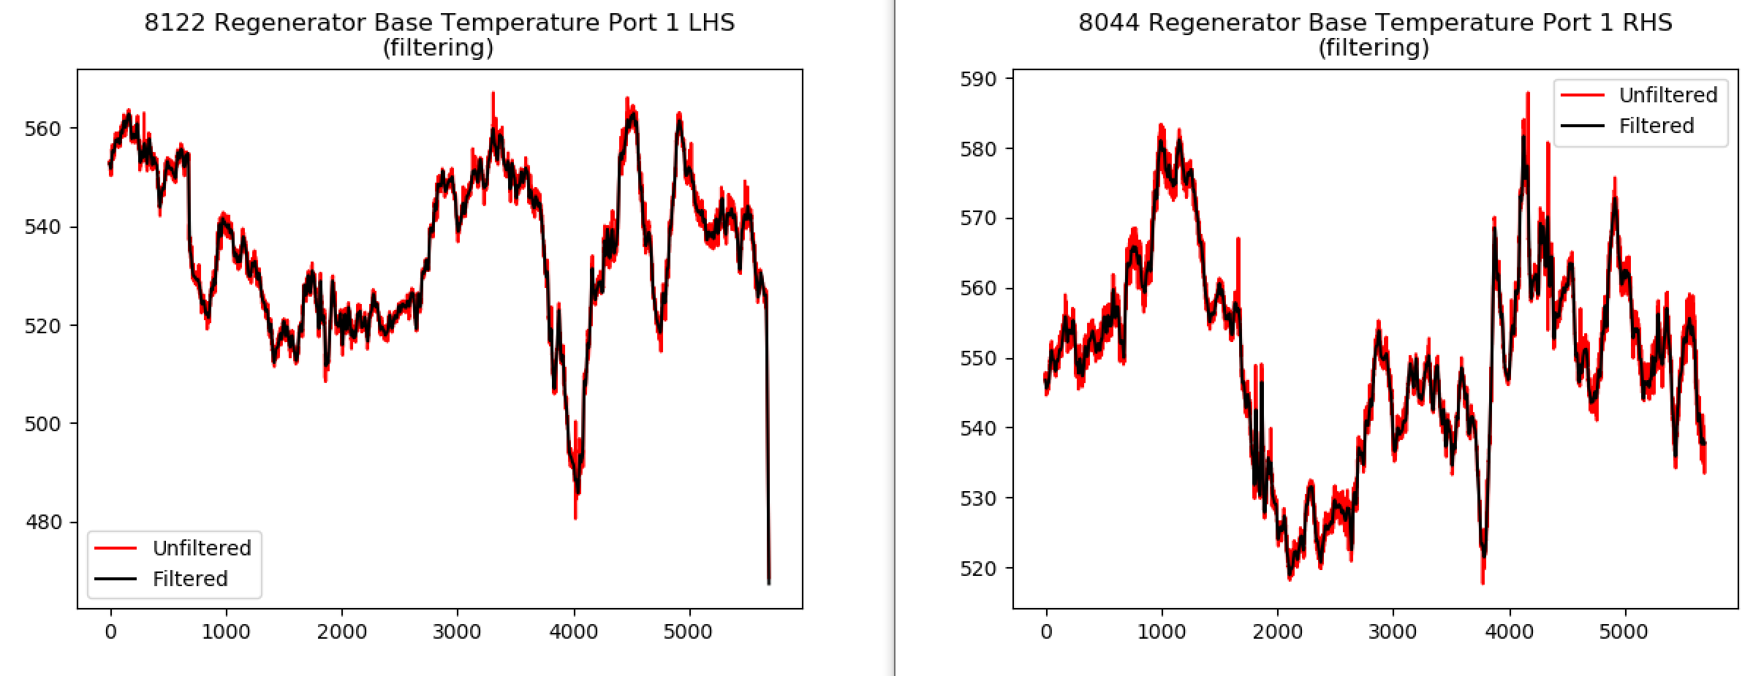
Data Processing Pipeline (Regenerator Base and Regenerator Crown Temperatures)
Identify pair of tags to be combined
Read raw data and time lag
Extract values & time stamps
Isolate over time period
Reversal processing
Remove spikes
Data not found
Interpolate
Signal 1
Low pass filter
Signal 2
Difference between 2 signals

Slide 11
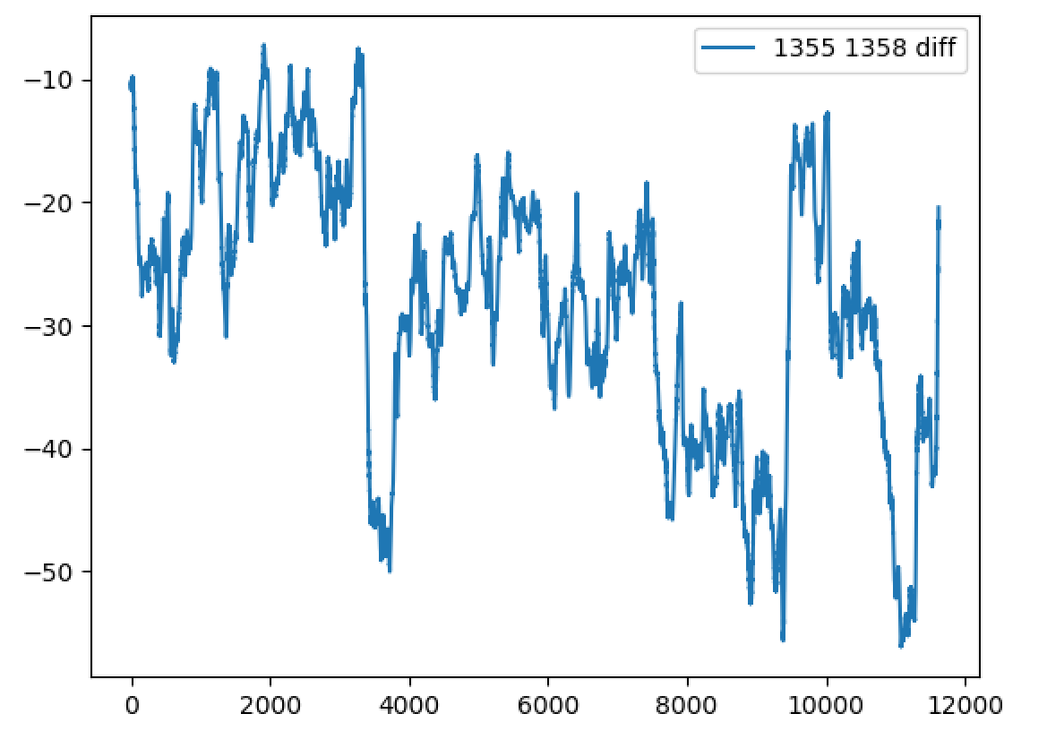
Data Processing Pipeline (Regenerator Base and Regenerator Crown Temperatures)
Identify pair of tags to be combined
Read raw data and time lag
Extract values & time stamps
Isolate over time period
Reversal processing
Remove spikes
Data not found
Interpolate
Signal 1
Low pass filter
Signal 2
Difference between 2 signals

Slide 12
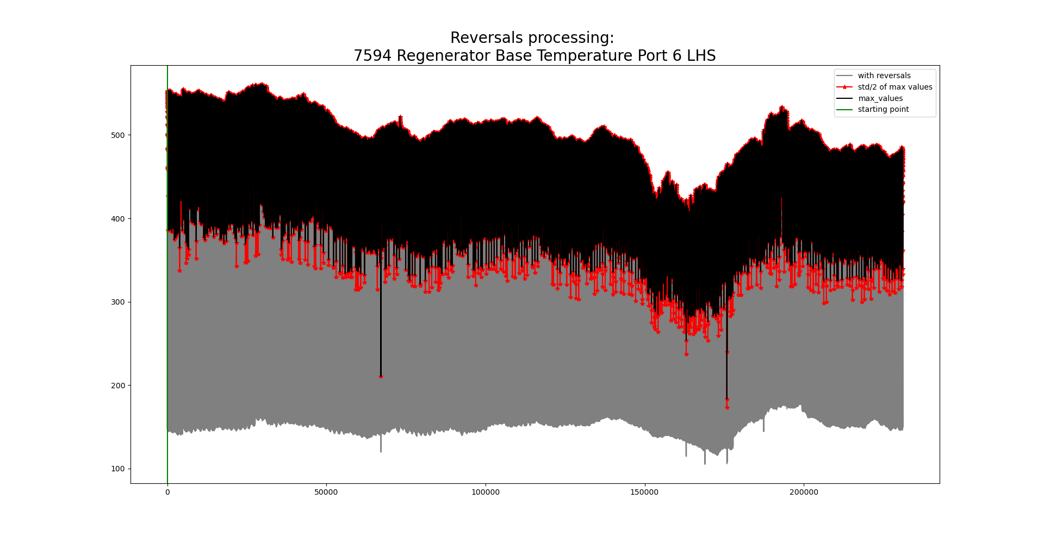
Reversals: before

Slide 13
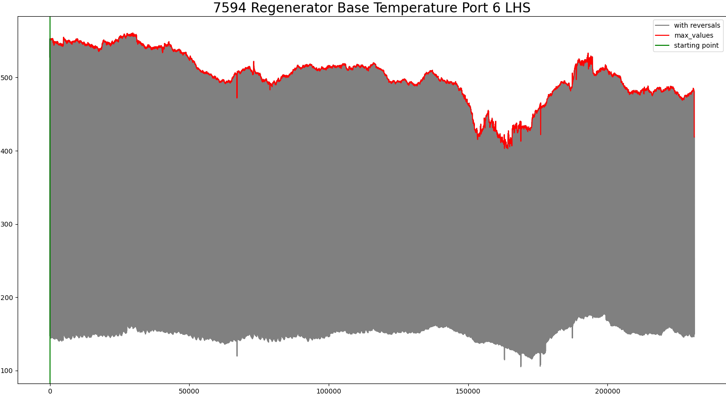
Reversals: we now have
Search for the minimum value of the signal at the first 40 minutes to identify the point at firing.
Capture the max value of the signal within a 40-minute time period

Slide 14
Reversals
Search for the minimum value of the signal at the first 40 minutes to identify the point at firing.
Capture the max value of the signal within a 40-minute time period

Slide 15
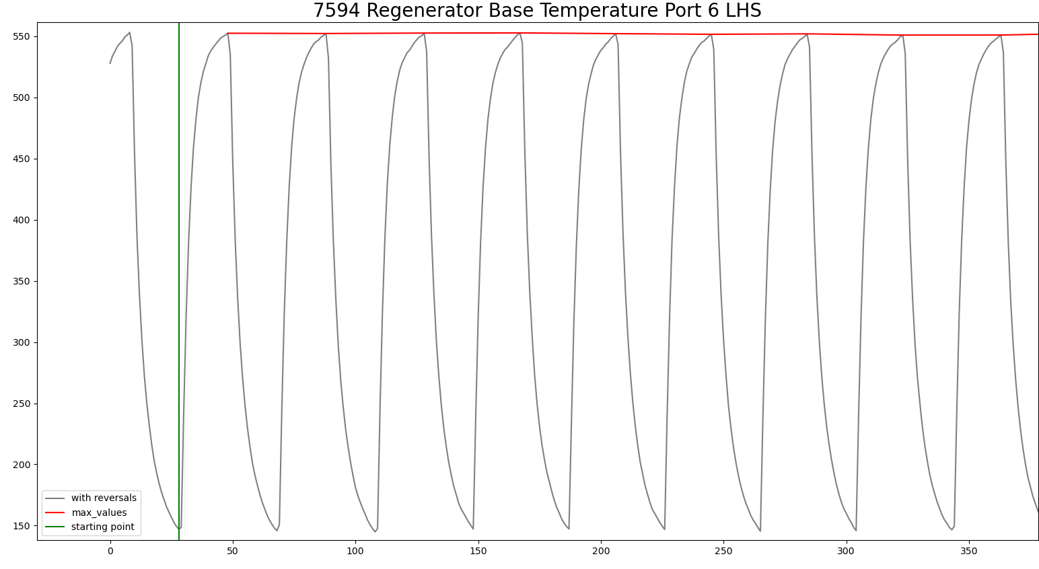
Reversals
Search for the minimum value of the signal at the first 40 minutes to identify the point at firing.
Capture the max value of the signal within a 40-minute time period

Slide 16
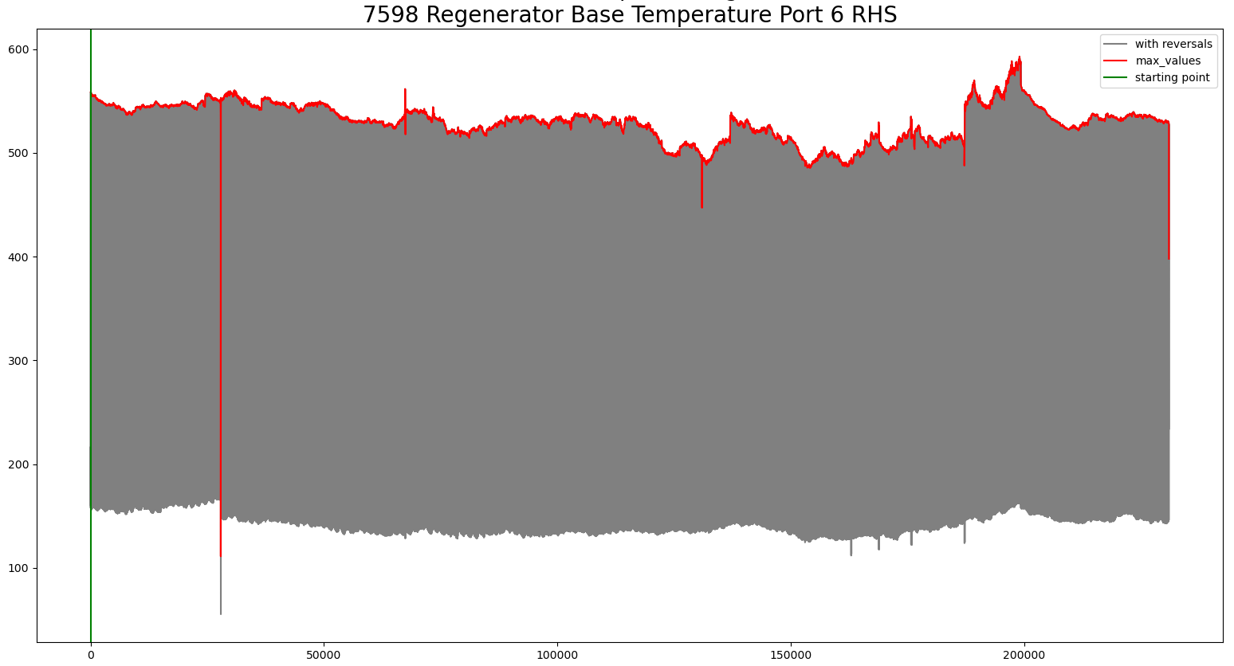
Reversals

Slide 17
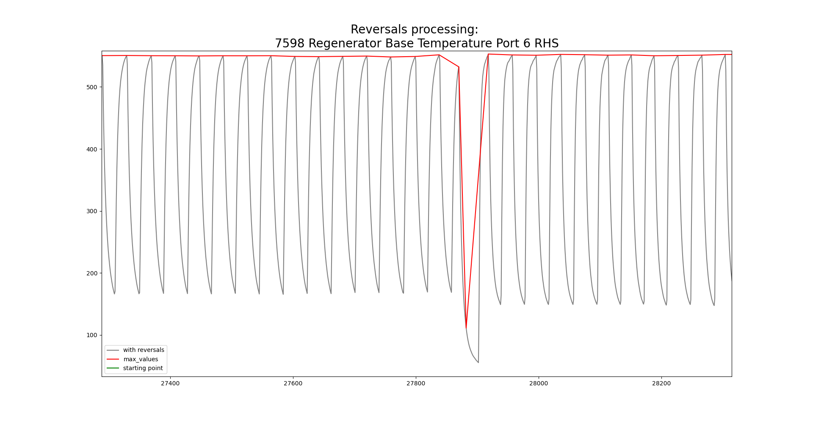
Reversals: signals ready to be combined

Slide 18
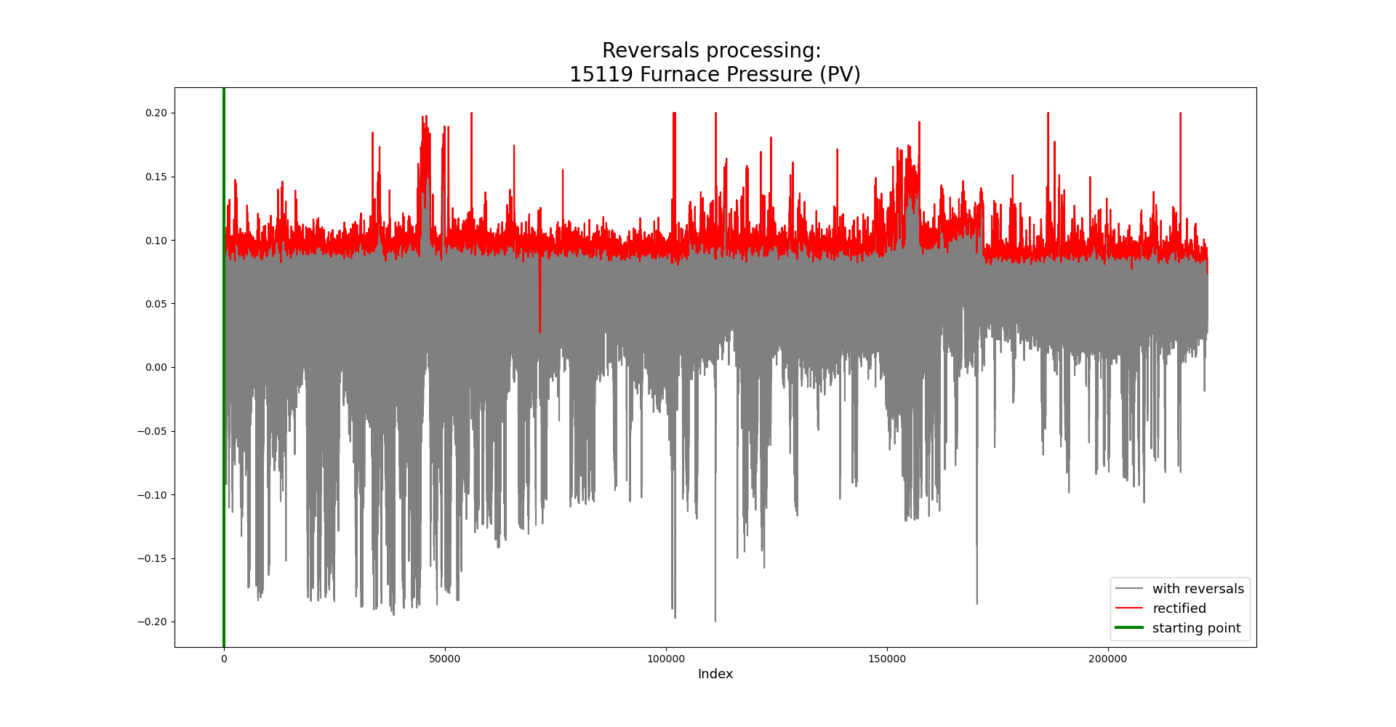
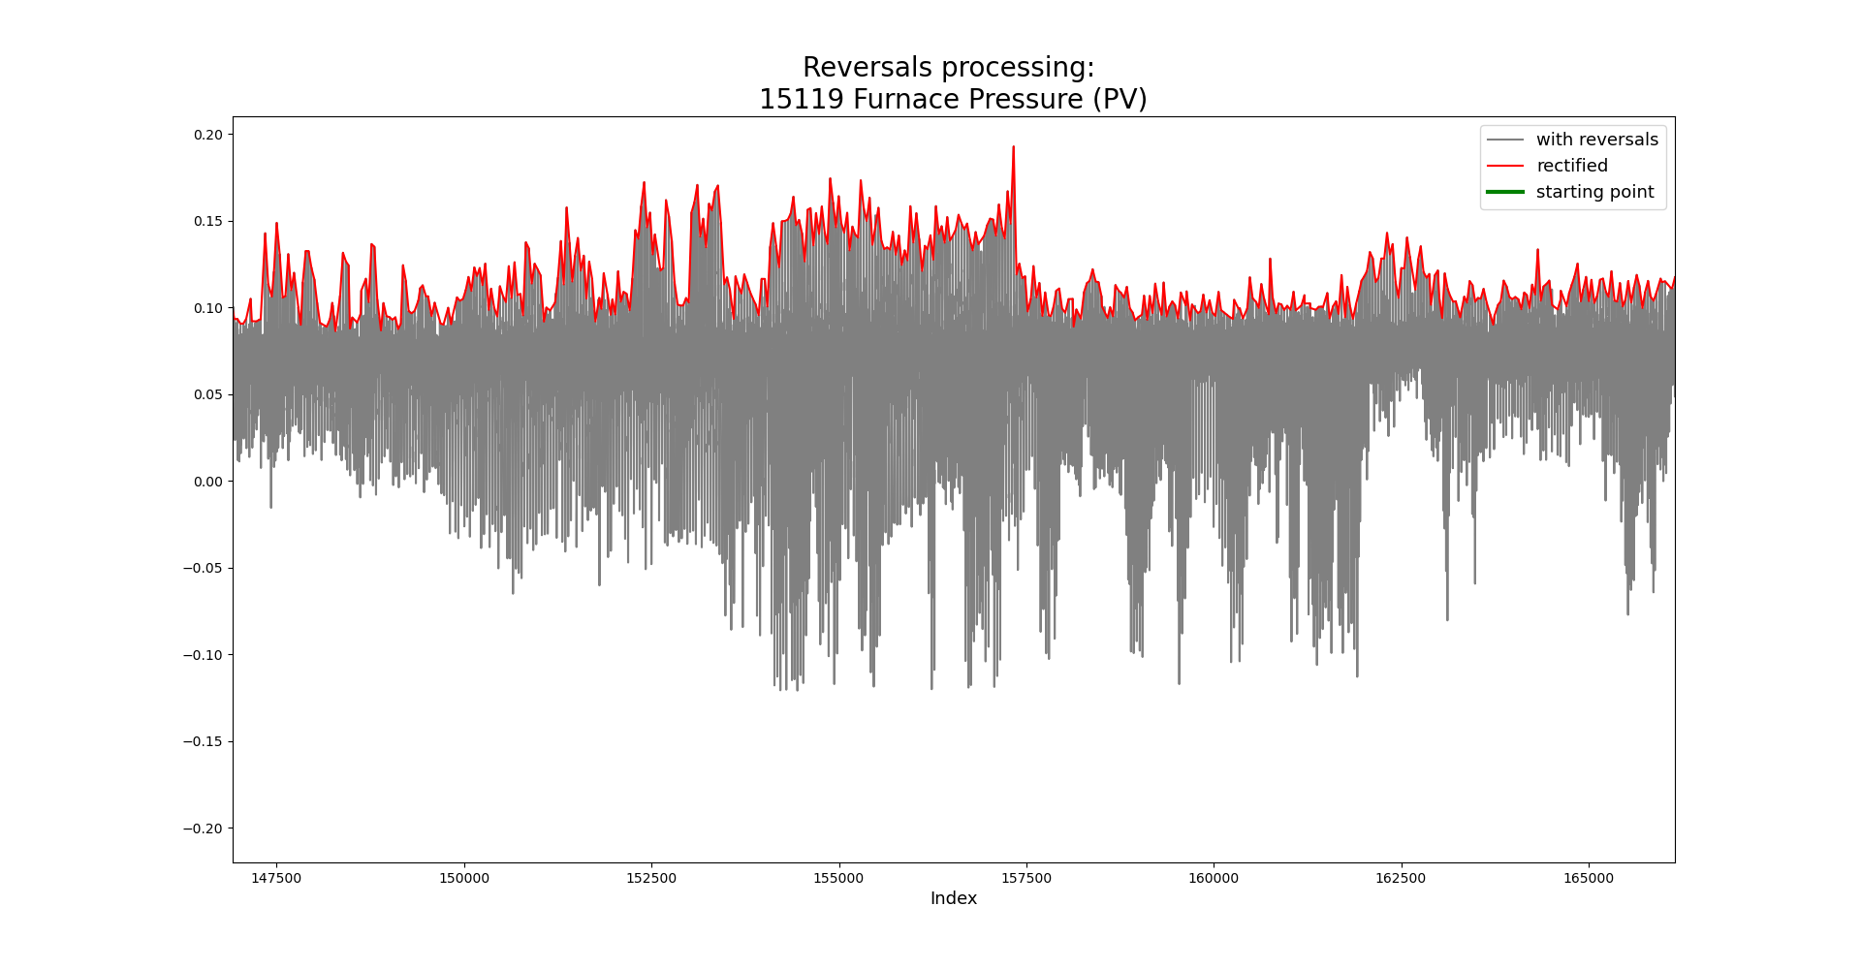
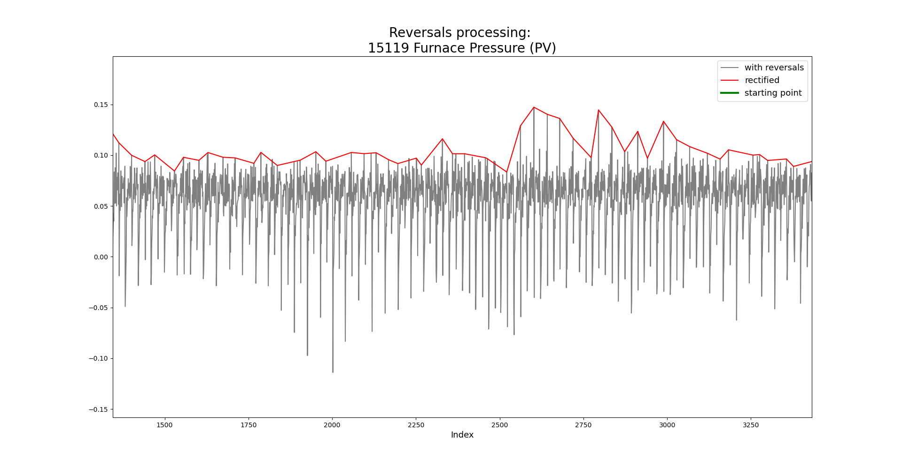
Inputs labeled for reversals conditioning (combine=0)
Zoom in
More zoom in

Slide 19
Data Processing Pipeline (Combustion Air Flow)
Identify pair of tags to be combined
Read raw data and time lag
Extract values & time stamps
Isolate over time period
Combine by taking max
Remove spikes
Data not found
Interpolate
Low pass filter
Combined signal

Slide 20
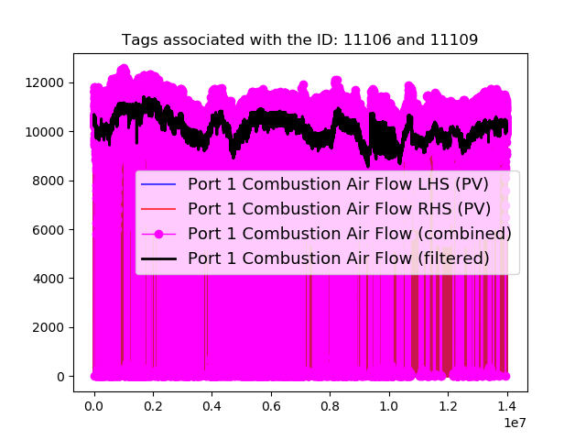
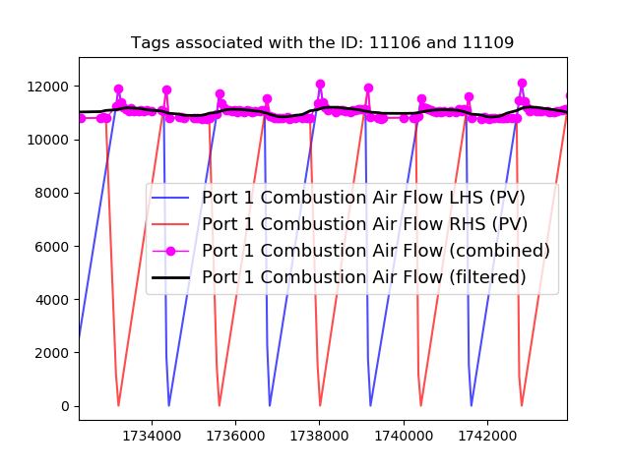
Combinations (Combustion Air Flow)

Slide 21
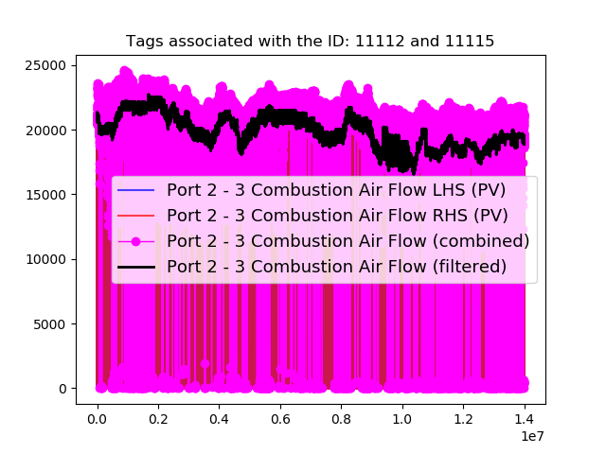
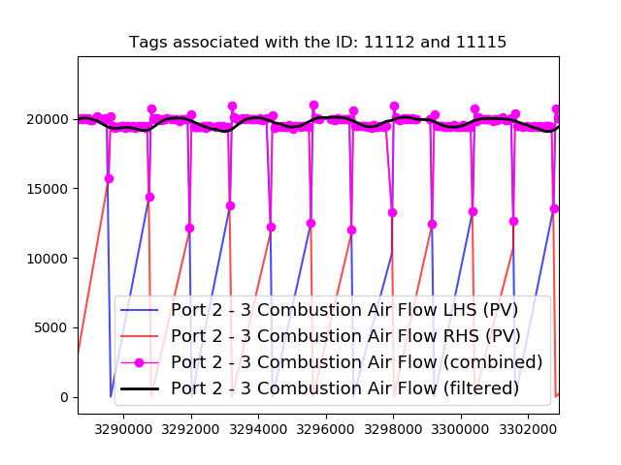
Combinations (Combustion Air Flow)

Slide 22
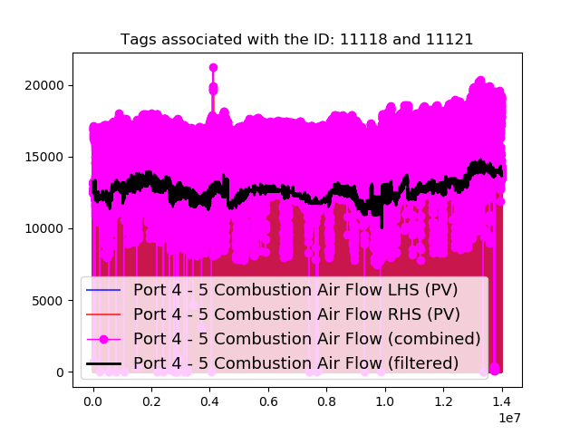
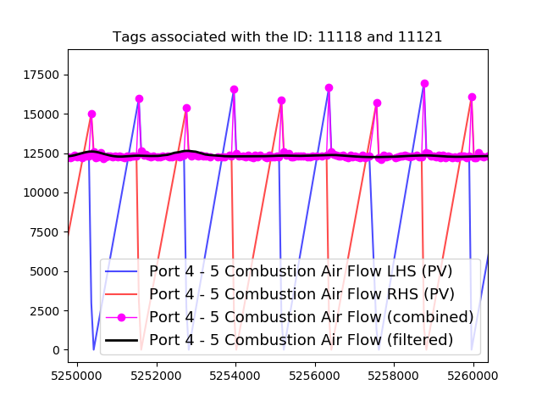
Combinations (Combustion Air Flow)

Slide 23
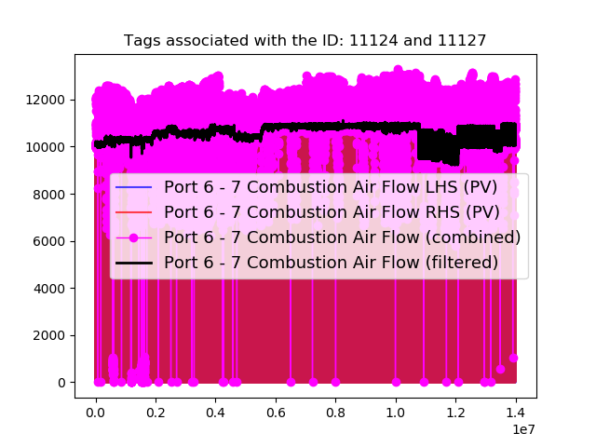
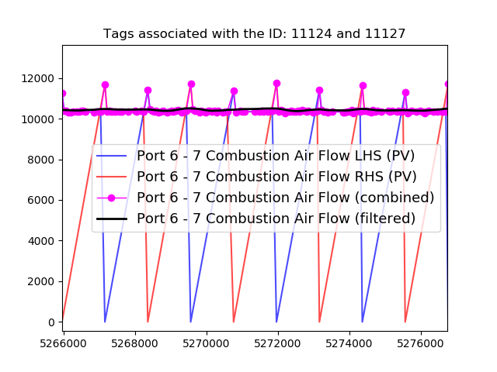
Combinations (Combustion Air Flow)

Slide 24
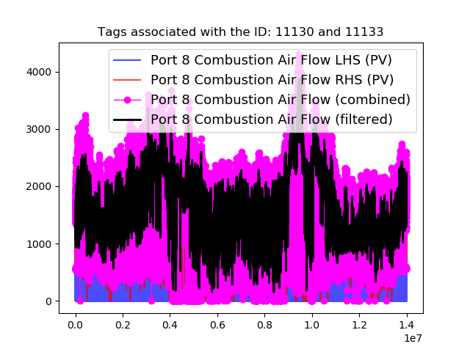
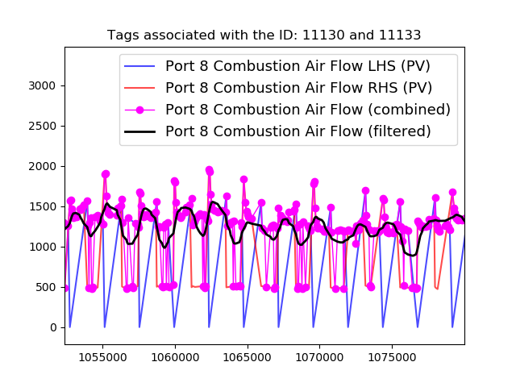
Combinations (Combustion Air Flow)

Slide 25
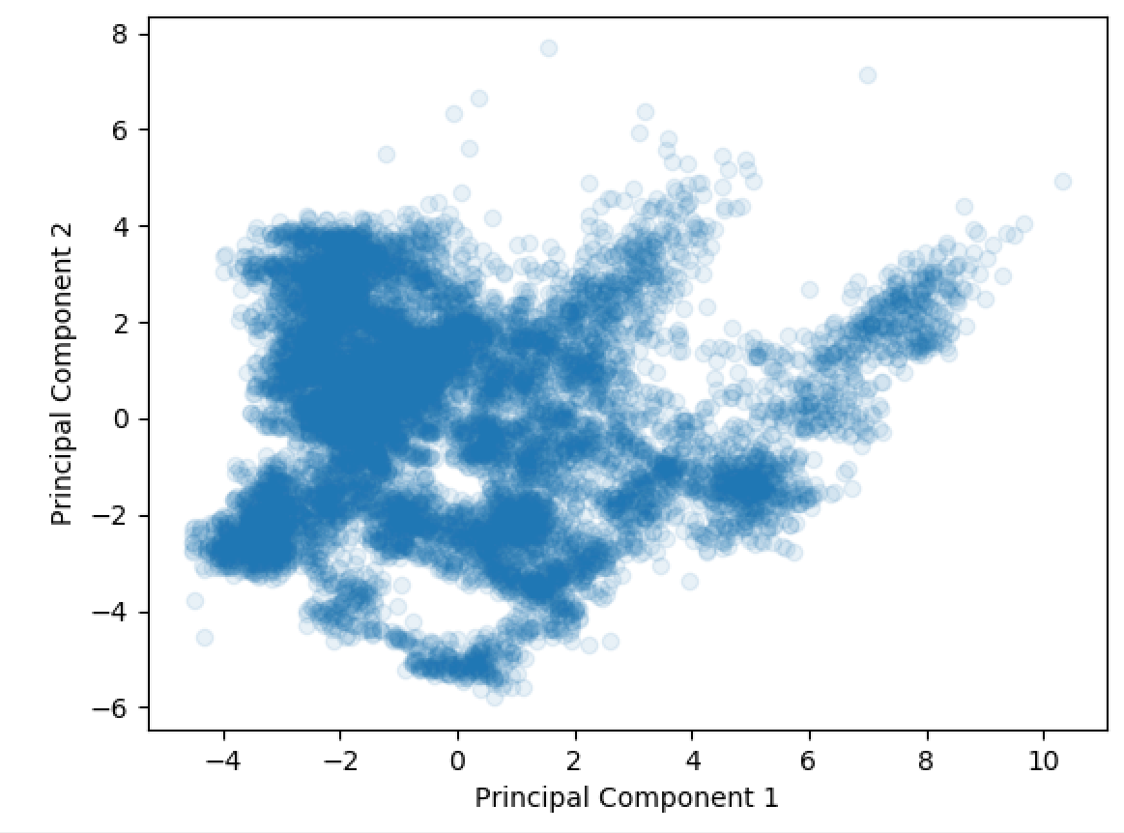
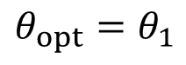
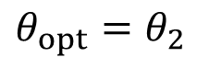
Mixture of Experts Approach
(Using the previous week’s PCA plot as an example.)
As we move between different states, we have different optimal parameters for the model.
Currently, after we move between states, the model needs to spend some time retuning its parameters.
We originally suggested a model with time-varying parameters because we know that the furnace will change over time (degradation etc.)
But the PCA analysis shows that there are more severe, shorter-term changes in state as a result of product changes.
There isn’t a single linear model that can perform well over all of the different products.
$${θ_{opt}=θ}_{1}$$
$${θ_{opt}=θ}_{2}$$

Slide 26
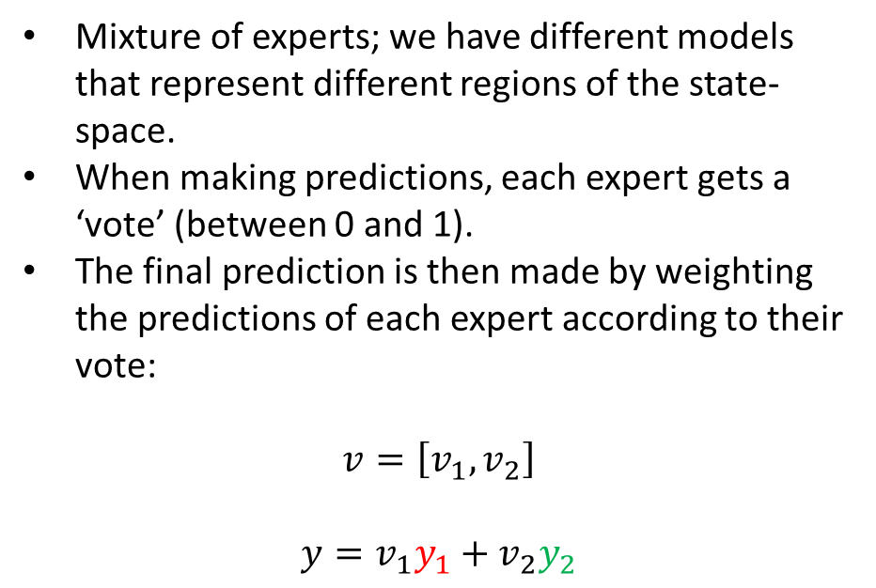
Mixture of Experts Approach
(Using the previous week’s PCA plot as an example.)
Mixture of experts; we have different models that represent different regions of the state-space.
When making predictions, each expert gets a ‘vote’ (between 0 and 1).
The final prediction is then made by weighting the predictions of each expert according to their vote:
$$v=\left[v_{1}, v_{2}\right]$$
$$y=v_{1}y_{1}+v_{2}y_{2}$$
$${θ_{opt}=θ}_{1}$$
Expert 1
Expert 2
$${θ_{opt}=θ}_{2}$$

Slide 27
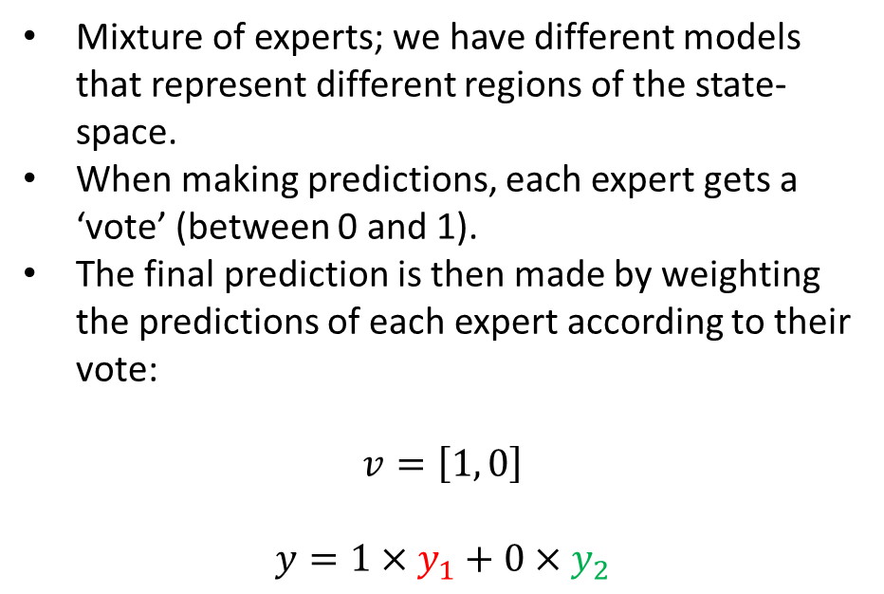
Mixture of Experts Approach
(Using the previous week’s PCA plot as an example.)
Mixture of experts; we have different models that represent different regions of the state-space.
When making predictions, each expert gets a ‘vote’ (between 0 and 1).
The final prediction is then made by weighting the predictions of each expert according to their vote:
$$v=\left[1, 0\right]$$
$$y=1×y_{1}+0×y_{2}$$
$${θ_{opt}=θ}_{1}$$
Expert 1
Expert 2
$${θ_{opt}=θ}_{2}$$

Slide 28

Mixture of Experts Approach
(Using the previous week’s PCA plot as an example.)
Mixture of experts; we have different models that represent different regions of the state-space.
When making predictions, each expert gets a ‘vote’ (between 0 and 1).
The final prediction is then made by weighting the predictions of each expert according to their vote:
$$v=\left[0, 1\right]$$
$$y=0×y_{1}+1×y_{2}$$
$${θ_{opt}=θ}_{1}$$
Expert 1
Expert 2
$${θ_{opt}=θ}_{2}$$

Slide 29
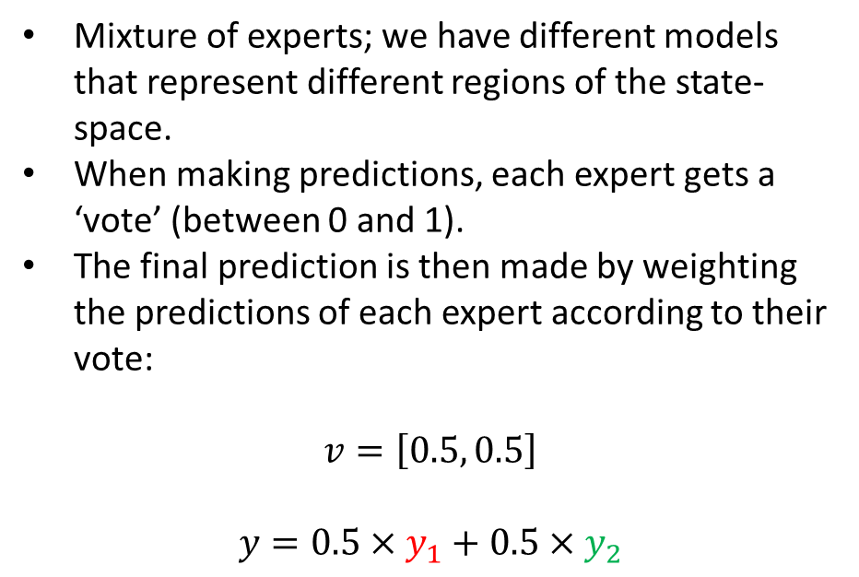
Mixture of Experts Approach
(Using the previous week’s PCA plot as an example.)
Mixture of experts; we have different models that represent different regions of the state-space.
When making predictions, each expert gets a ‘vote’ (between 0 and 1).
The final prediction is then made by weighting the predictions of each expert according to their vote:
$$v=\left[0.5, 0.5\right]$$
$$y=0.5×y_{1}+0.5×y_{2}$$
$${θ_{opt}=θ}_{1}$$
Expert 1
Expert 2
$${θ_{opt}=θ}_{2}$$

